Slide 1
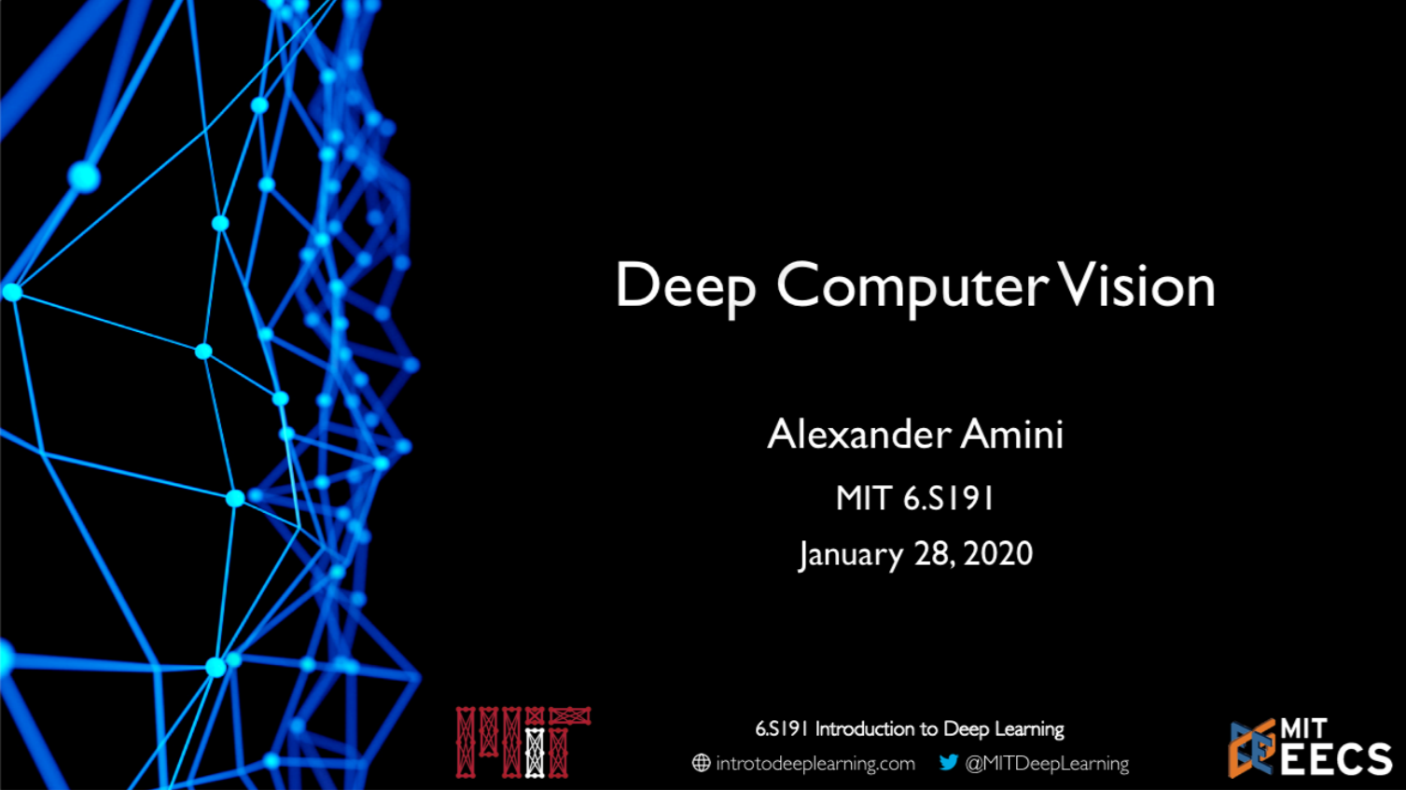

Slide 2
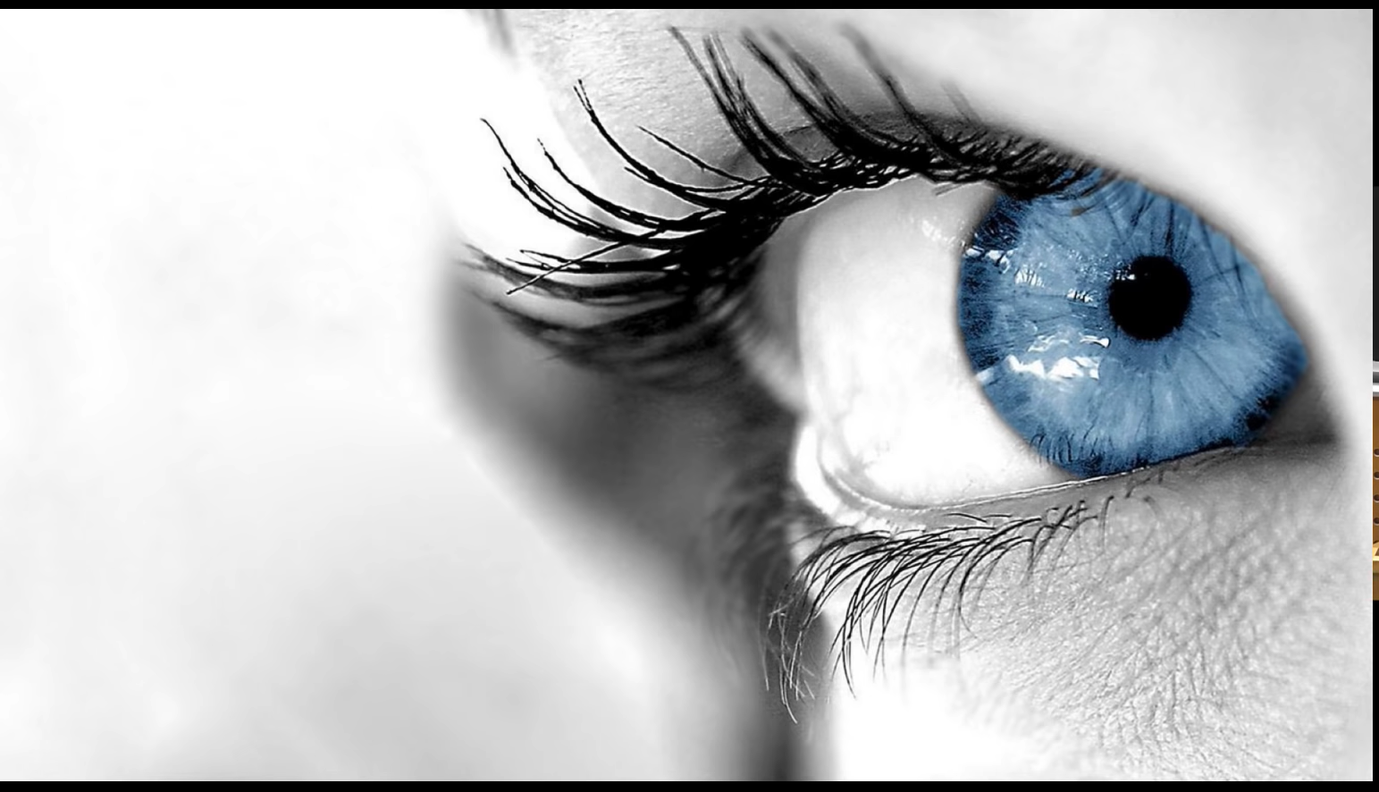
© Alexander Amini and Ava Soleimany MIT 6.S191: Introduction to Deep Learning IntroToDeepLearning.com

Slide 3
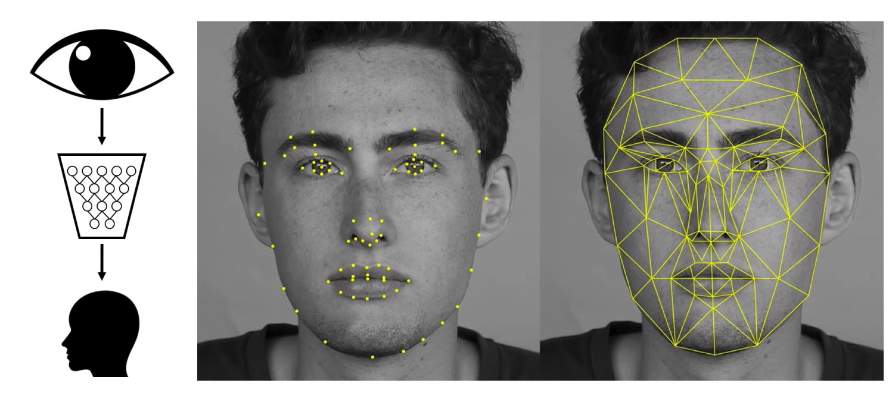
Impact: Facial Detection and Recognition
© Alexander Amini and Ava Soleimany MIT 6.S191: Introduction to Deep Learning IntroToDeepLearning.com

Slide 4
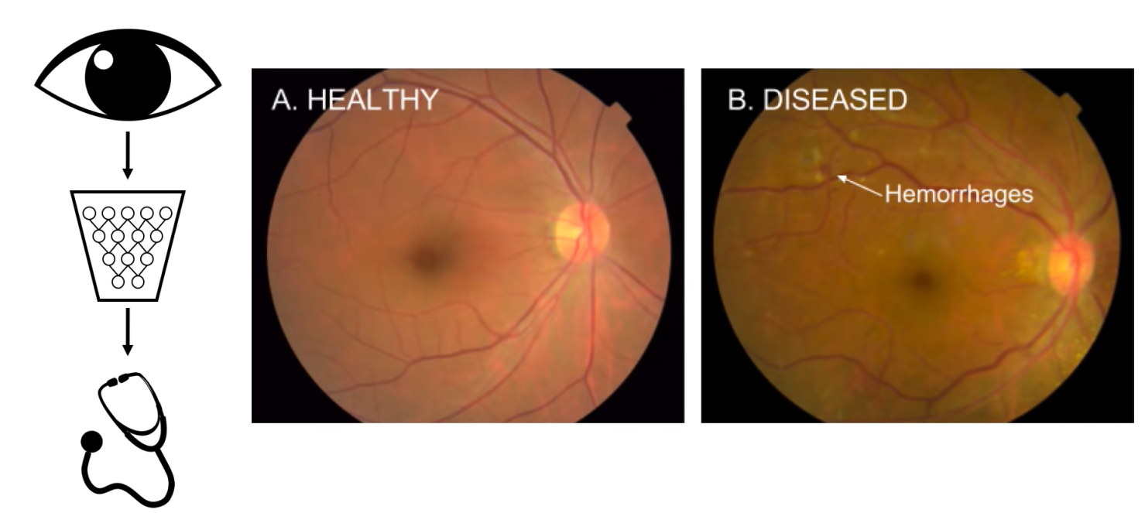
Impact: Medicine, Biology, Healthcare
© Alexander Amini and Ava Soleimany MIT 6.S191: Introduction to Deep Learning IntroToDeepLearning.com

Slide 5
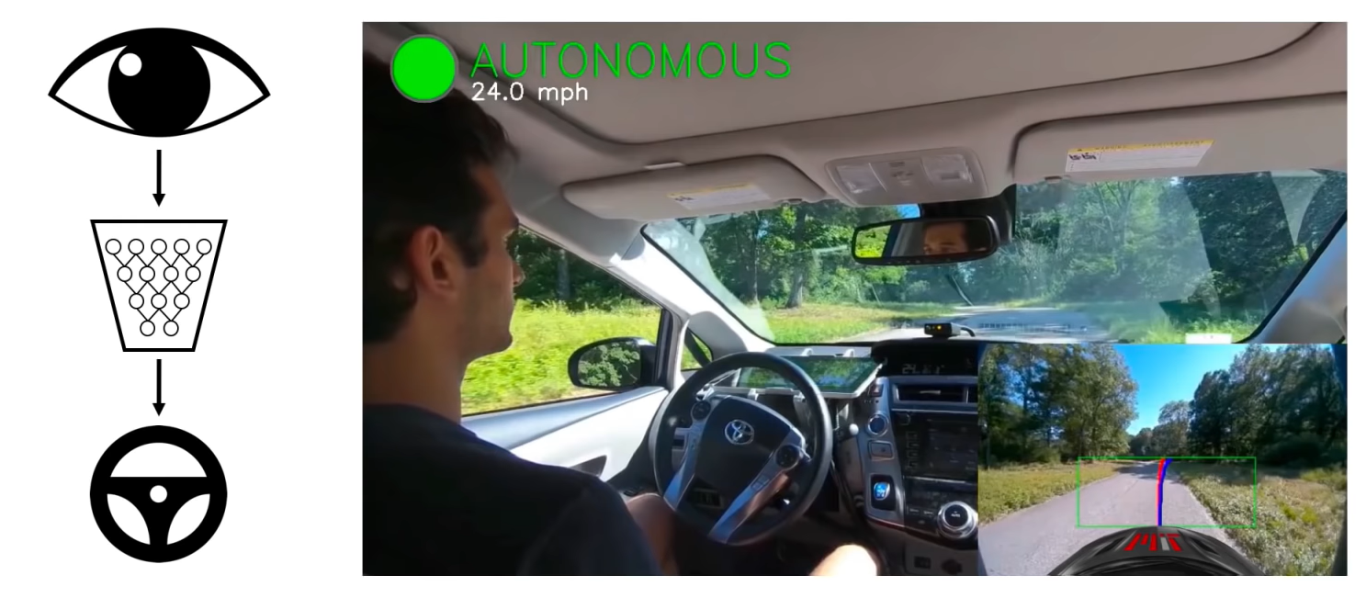
Impact: Self Driving Cars

Slide 6
What Computers “See”

Slide 7
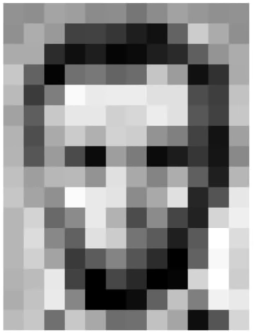
Images are Numbers

Slide 8
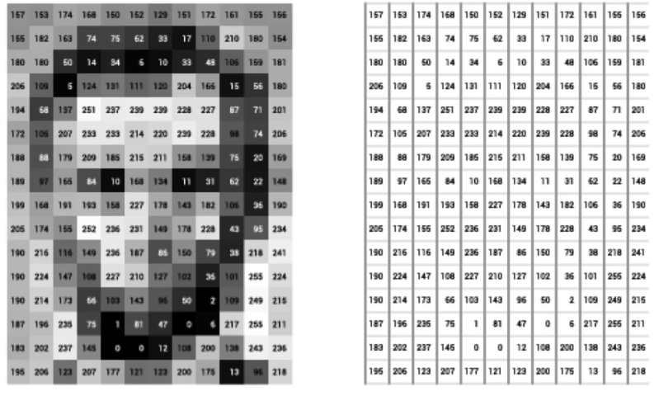
Images are Numbers

Slide 9
Images are Numbers
What the computer sees
An image is just a matrix of numbers [0,255]!
i.e., 1080x1080x3 for an RGB image

Slide 10
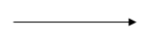
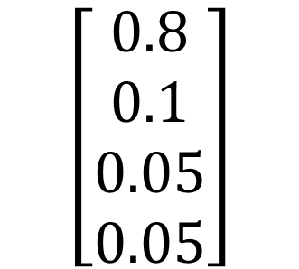
Tasks in Computer Vision
Lincoln
Washington
Jefferson
Obama
$$\left[\begin{matrix}0.8 \\ 0.1 \\ 0.05 \\ 0.05\end{matrix}\right]$$
Classification
Image Input
Pixel Representation
Regression: output value takes continuous value
Classification: output variable takes class label. Can produce probability of belonging to a particular class

Slide 11
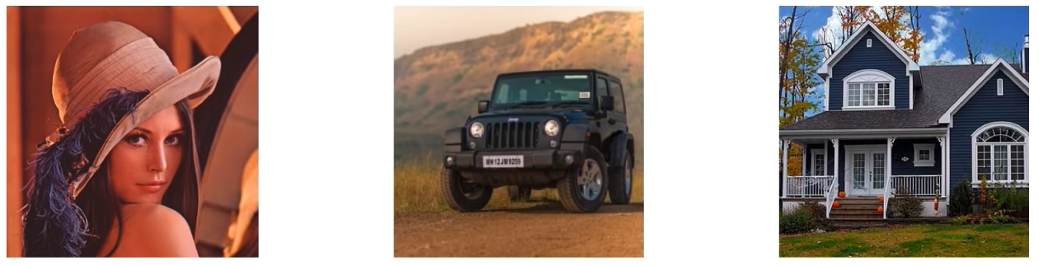
High Level Feature Detection
Let’s identify key features in each image category
Nose, Eyes, Mouth
Wheels, License Plate, Headlights
Door, Windows, Steps

Slide 12
Manual Feature Extraction
Domain Knowledge
Define Features
Detect Features to Classify
Problems?

Slide 13
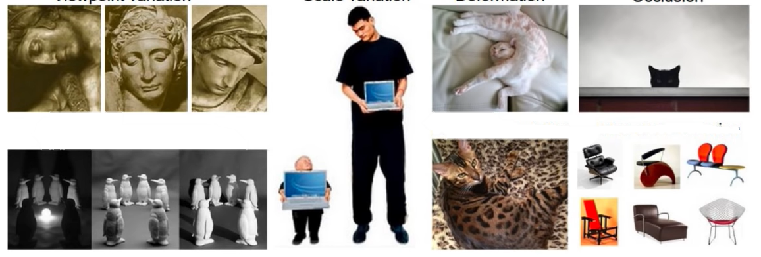
Manual Feature Extraction
Domain Knowledge
Define Features
Detect Features to Classify
Viewpoint Variation
Scale Variation
Deformation
Occlusion
Illumination conditions
Background Clutter
Intra-Class Variation
© Alexander Amini and Ava Soleimany MIT 6.S191: Introduction to Deep Learning IntroToDeepLearning.com

Slide 14
Manual Feature Extraction
Domain Knowledge
Define Features
Detect Features to Classify
Viewpoint Variation
Scale Variation
Deformation
Occlusion
Illumination conditions
Background Clutter
Intra-Class Variation
© Alexander Amini and Ava Soleimany MIT 6.S191: Introduction to Deep Learning IntroToDeepLearning.com

Slide 15
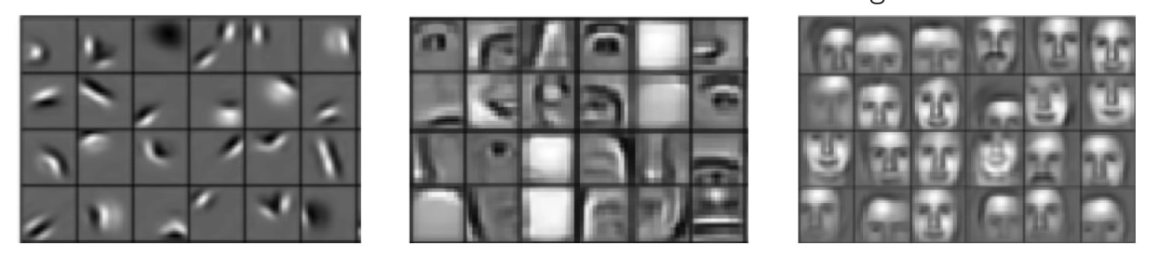
Learning Feature Representation
Can we learn a hierarchy of features directly from the data instead of hand engineering?
Low level features
Mid level features
High level features
Edges, dark spots
Eyes, ears, nose
Facial structure

Slide 16
Learning Visual Features

Slide 17
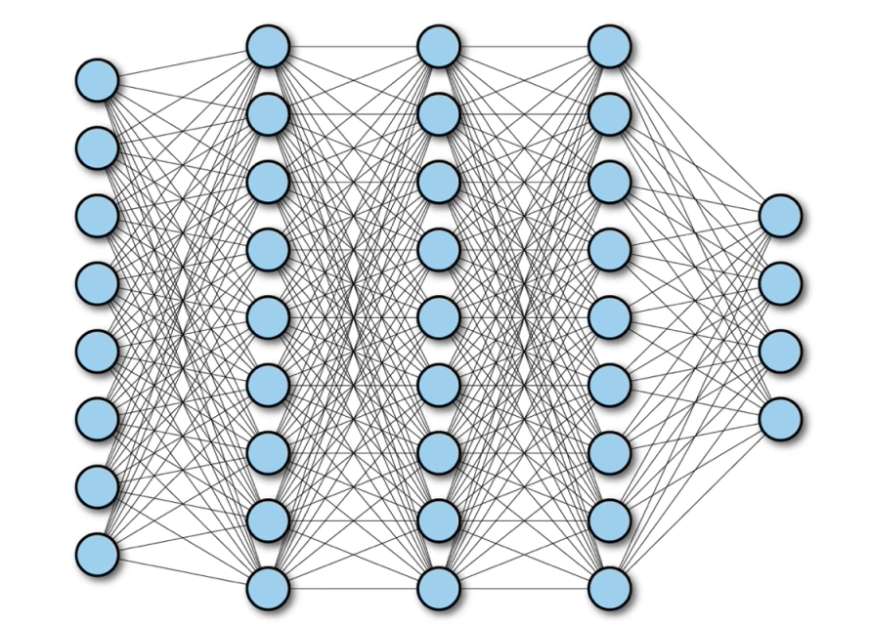
Fully Connected Neural Network

Slide 18
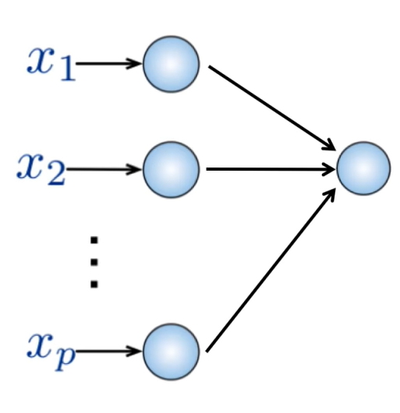
Fully Connected Neural Network
Input
2D image
Vector of pixel values
Fully connected
Connect neuron in hidden layer to all neurons in input layer
No spatial information
And many, many parameters

Slide 19
Fully Connected Neural Network
Input
2D image
Vector of pixel values
Fully connected
Connect neuron in hidden layer to all neurons in input layer
No spatial information
And many, many parameters
How can we use spatial structure in the input to inform the architecture of the network?

Slide 20
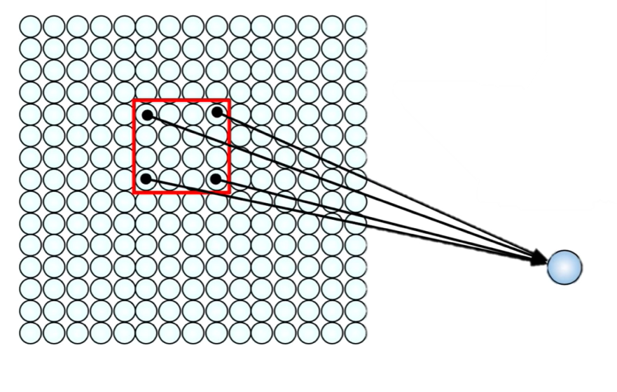
Using Spatial Structure
Input: 2D image. Array of pixel values
Idea: connect patches of input to neurons in hidden layer.
Neuron connected to region of input. Only “sees” these values.

Slide 21
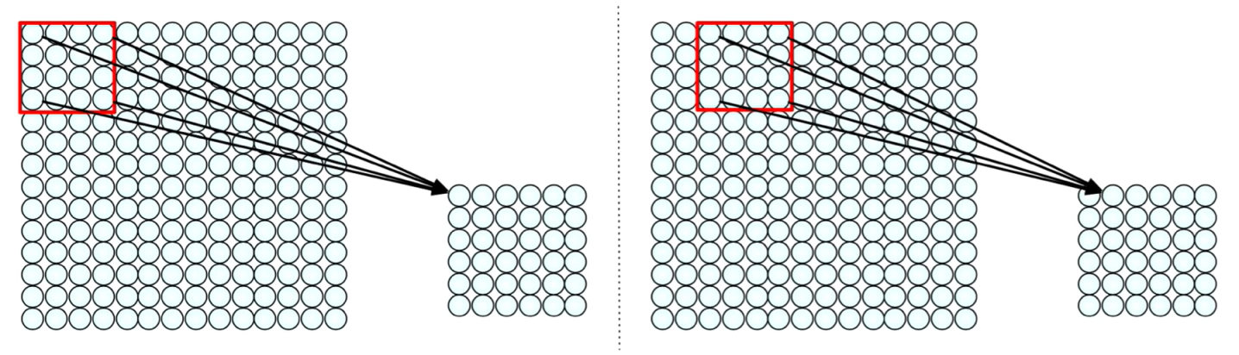
Using Spatial Structure
Connect patch in input layer to a single neuron in subsequent layer. Use a sliding window to define connections.
How can we weight the patch to detect particular features

Slide 22
Applying Filters to Extract Features
Apply a set of weights – a filter – to extract local filters
Use multiple filters to extract different features
Spatially share parameters of each filter
(features that matter in one part of the input should matter somewhere else)

Slide 23
Feature Extraction with Convolution
Filter of size 4x4: 16 different weights
Apply this same filter to 4x4 patches in input
Shift by 2 pixels for next patch
This “patchy” operation is convolution
Apply a set of weights – a filter – to extract local features
Use multiple filters to extract different features
Spatially share parameters of each filter

Slide 24
Feature Extraction and Convolution
A Case study

Slide 25
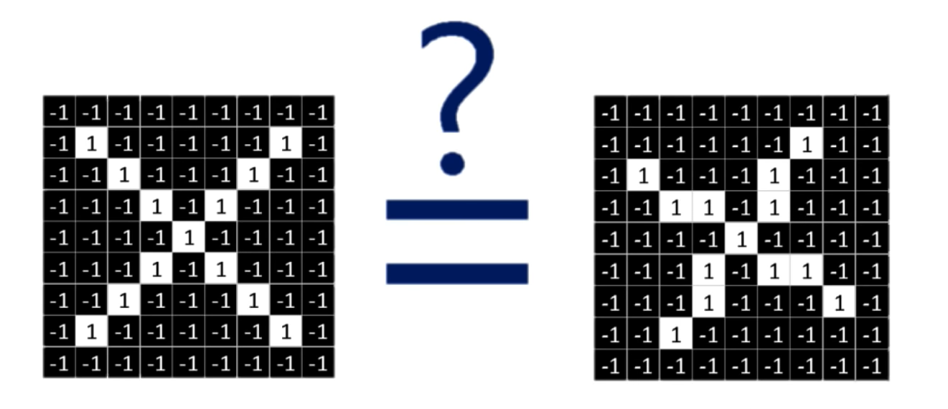
X or X?
Image is represented as a matrix of pixel values… and computers are literal!
We want to classify X as an X even if it’s shifted, shrunk, rotated, or deformed.

Slide 26
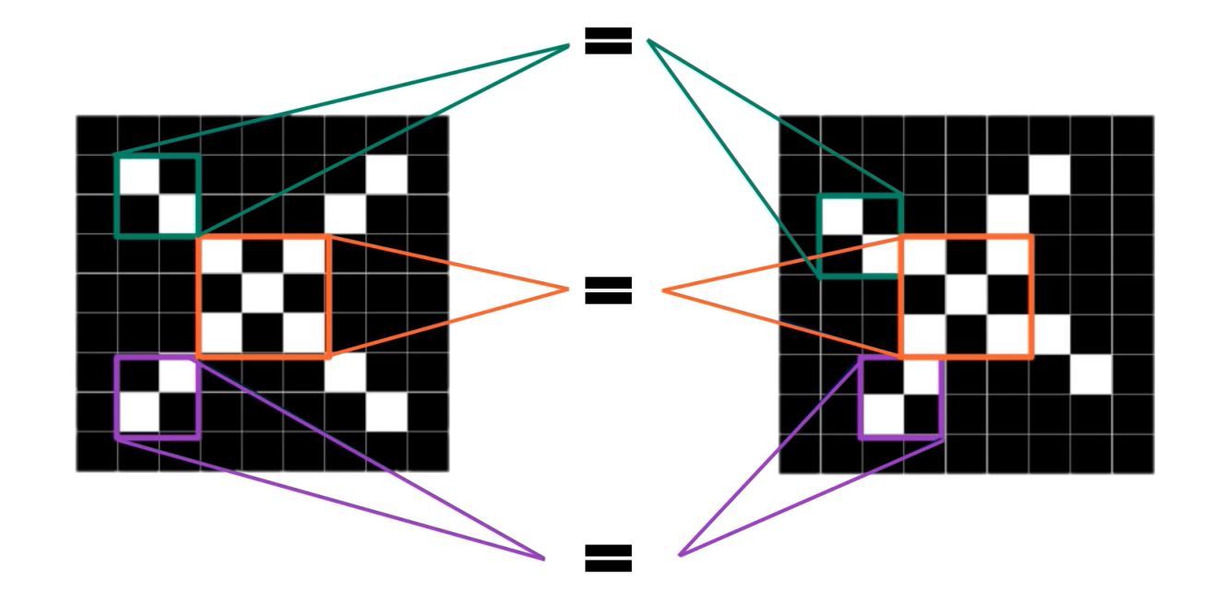
Features of X
© Alexander Amini and Ava Soleimany MIT 6.S191: Introduction to Deep Learning IntroToDeepLearning.com

Slide 27
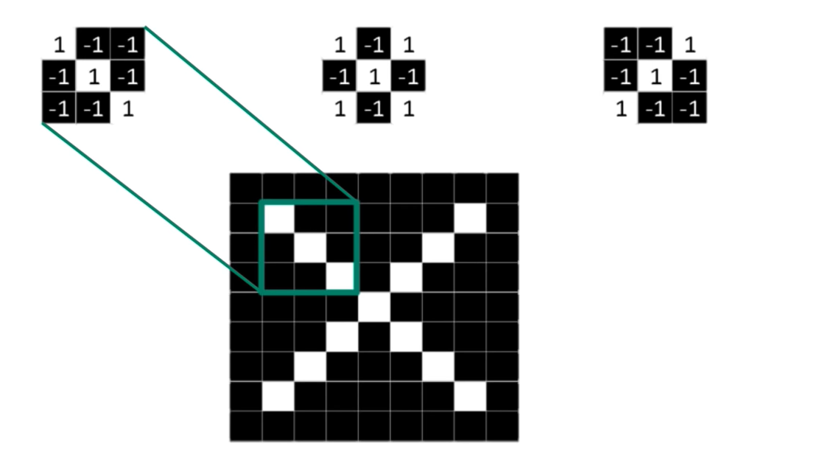
Filters to Detect X Features
filters

Slide 28
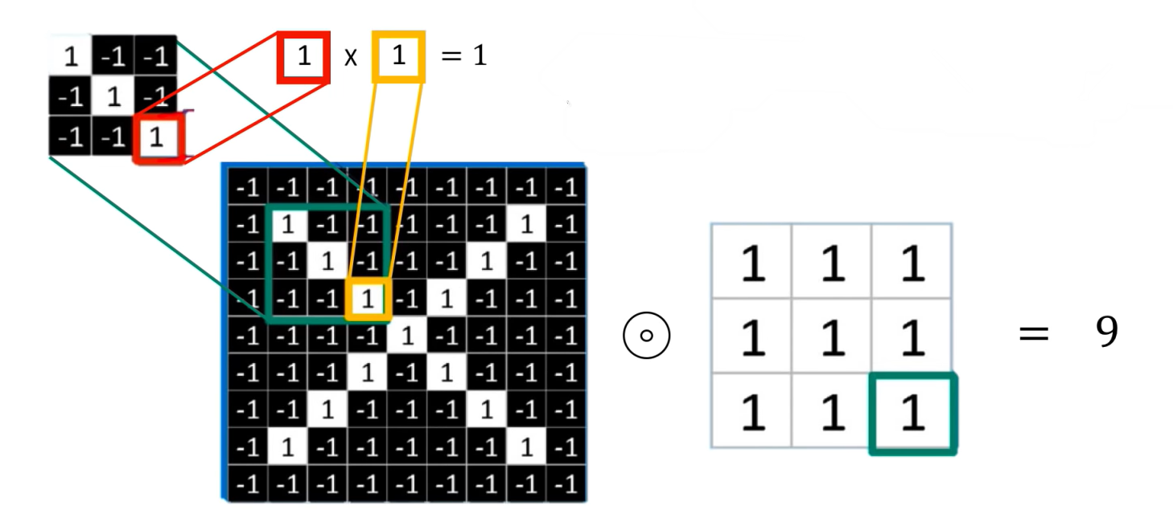
The Convolution Operation
Element wise supply
Add outputs
© Alexander Amini and Ava Soleimany MIT 6.S191: Introduction to Deep Learning IntroToDeepLearning.com

Slide 29
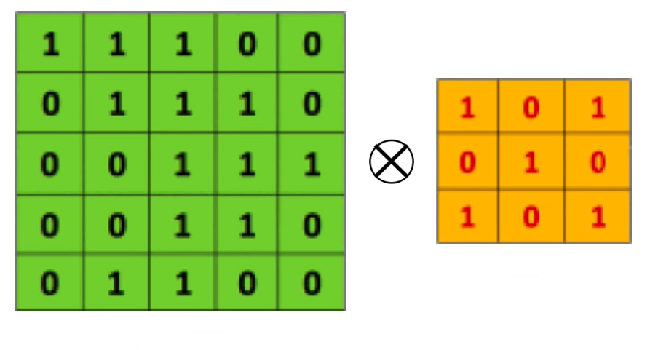
The Convolution Operation
Suppose we want to compute the convolution of a 5x5 image and a 3x3 filter
filter
image
We slide the filter over the input image, element-wise multiply, and add the outputs…

Slide 30
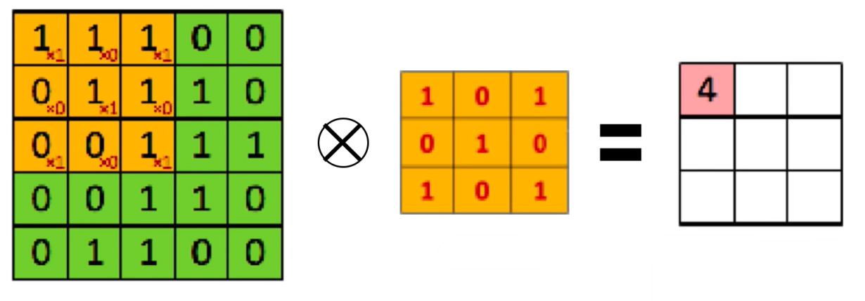
The Convolution Operation
We slide the 3x3 filter over the input image, element-wise multiply, and add the outputs
filter
feature map

Slide 31
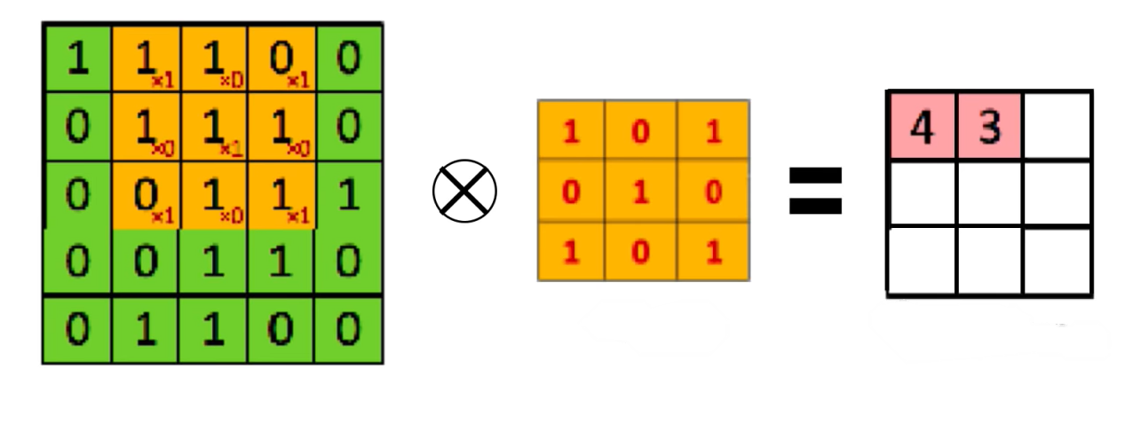
The Convolution Operation
We slide the 3x3 filter over the input image, element-wise multiply, and add the outputs
filter
feature map

Slide 32
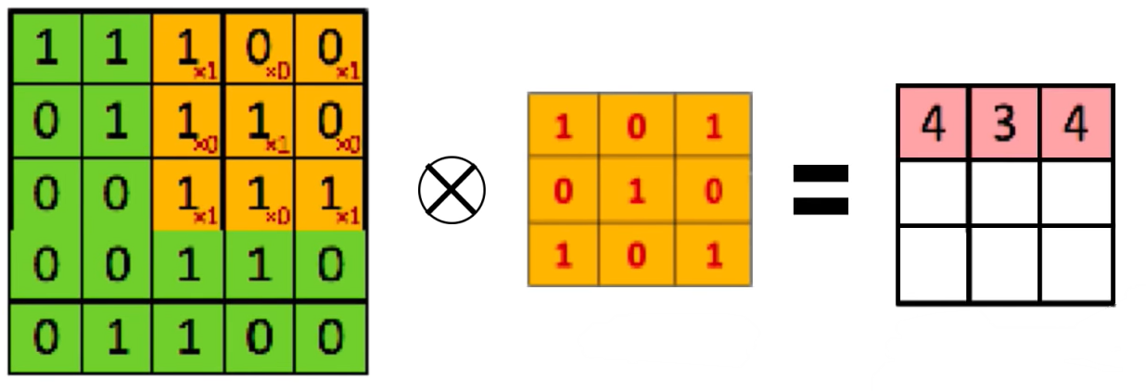
The Convolution Operation
We slide the 3x3 filter over the input image, element-wise multiply, and add the outputs
filter
feature map

Slide 33
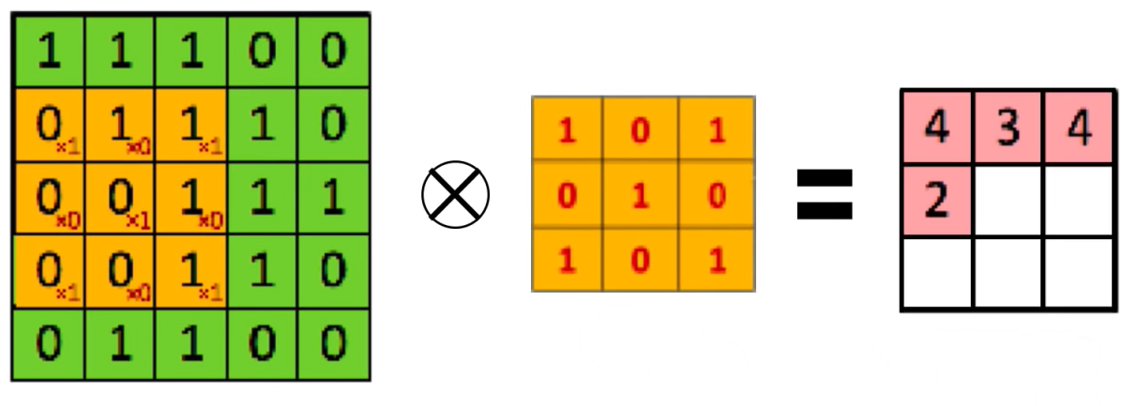
The Convolution Operation
We slide the 3x3 filter over the input image, element-wise multiply, and add the outputs
filter
feature map

Slide 34
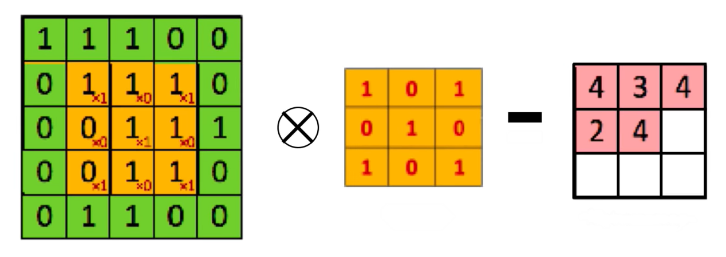
The Convolution Operation
We slide the 3x3 filter over the input image, element-wise multiply, and add the outputs
filter
feature map

Slide 35
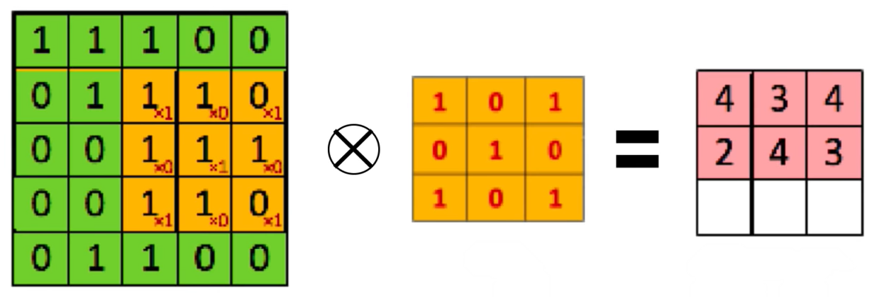
The Convolution Operation
We slide the 3x3 filter over the input image, element-wise multiply, and add the outputs
filter
feature map

Slide 36
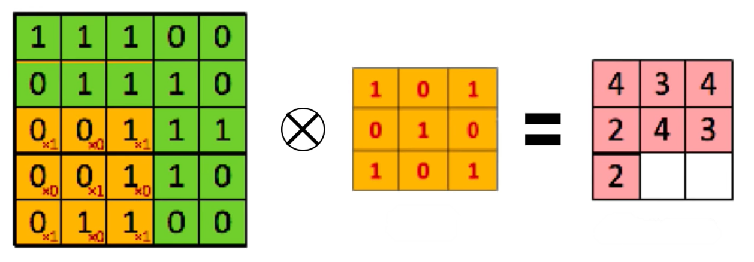
The Convolution Operation
We slide the 3x3 filter over the input image, element-wise multiply, and add the outputs
filter
feature map

Slide 37
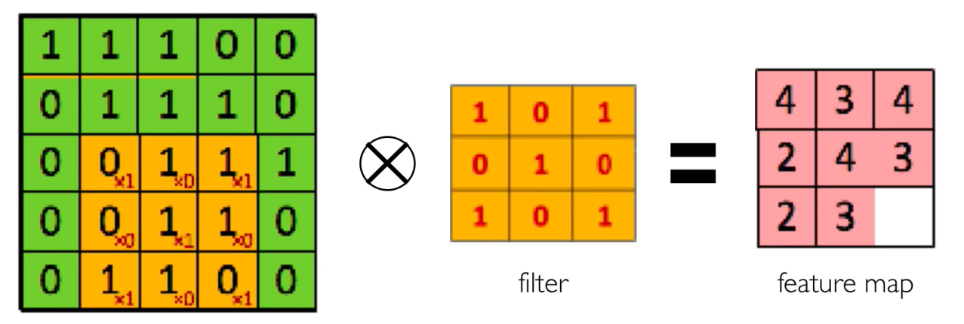
The Convolution Operation
We slide the 3x3 filter over the input image, element-wise multiply, and add the outputs
filter
feature map

Slide 38
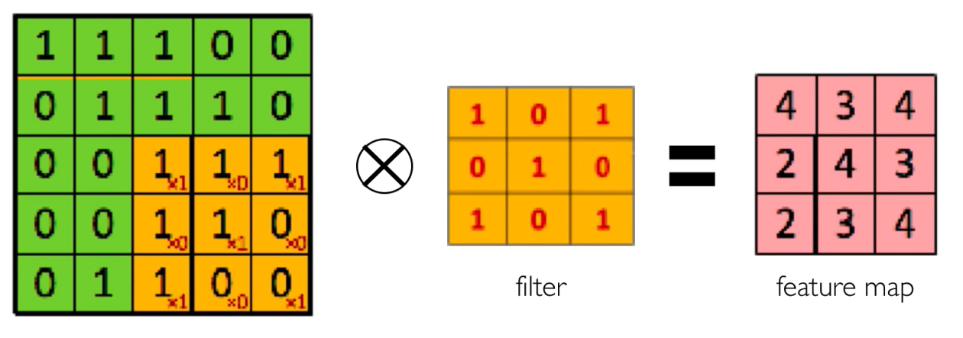
The Convolution Operation
We slide the 3x3 filter over the input image, element-wise multiply, and add the outputs
filter
feature map

Slide 39
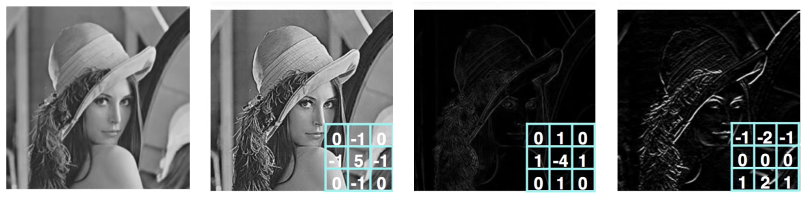
Producing Feature Maps
Original
Sharpen
Edge Detect
“Strong” Edge Detect

Slide 40
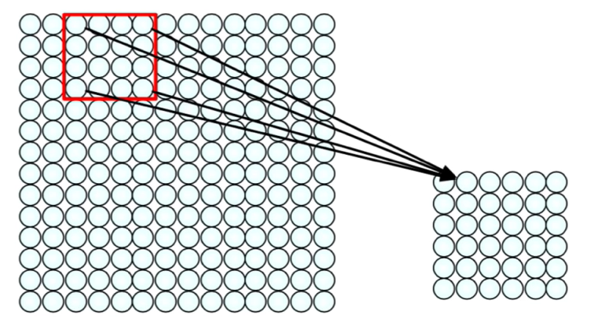
Feature Extraction with Convolution
Apply a set of weights – a filter – to extract local features
Use multiple filters to extract different features
Spatially share parameters of each filter

Slide 41
Convolutional Neural Networks (CNNs)

Slide 42
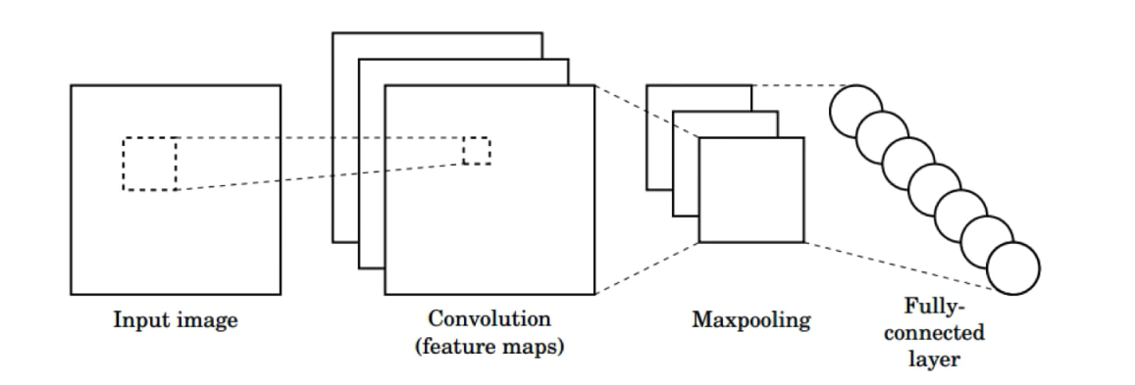

CNNs For Classification
Convolution: Apply filters to generate feature maps.
Non-linearity: Often ReLU.
Pooling: Downsampling operation on each feature map.
tf.keras.layers.Conv2D
tf.keras.activations.*
tf.keras.layers.MaxPool2D
Train model with image data.
Learn weights of filters in convolutional layers.

Slide 43
Convolutional Layers: Local Connectivity
tf.keras.layers.Conv2D
For a neuron in hidden layer
Take inputs from patch
Compute weighted sum
Apply bias

Slide 44
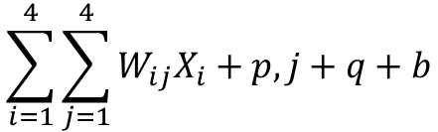
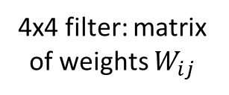
Convolutional Layers: Local Connectivity
tf.keras.layers.Conv2D
For a neuron in hidden layer
Take inputs from patch
Compute weighted sum
Apply bias
$$\sum_{i=1}^{4}{\sum_{j=1}^{4}{W_{ij}X_{i}+p,j+q+b}}$$
Applying a window of weights
Computing linear combinations
Activating with non-linear function
4x4 filter: matrix of weights $W_{ij}$
For neuron (p,q) in layer

Slide 45
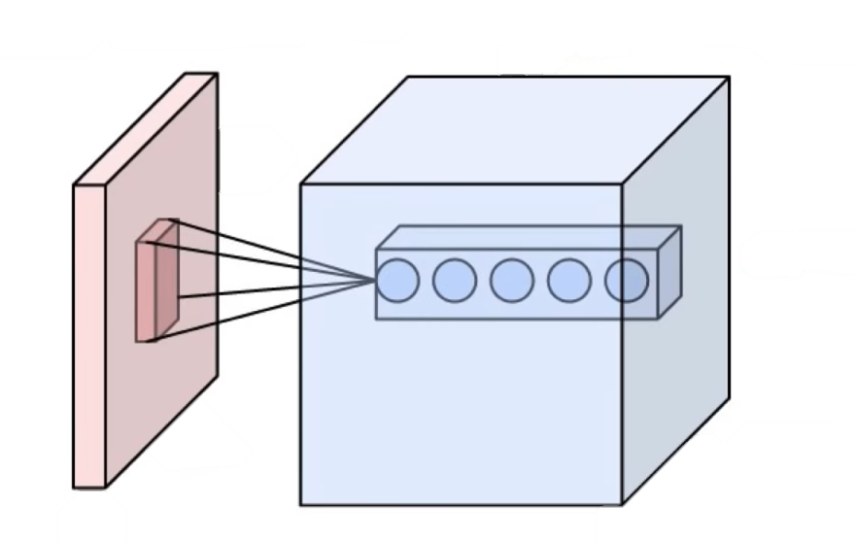
CNNs: Spatial Arrangement of Output Volume
Depth
Layer Dimensions:
h x w x d
Where h and w are spatial dimensions d(depth) = number of filters
Stride:
Filter step size
Receptive Field:
Locations in input image that a node is path connected to
32
Height
32
Width
3
tf.keras.layers.Conv2D( filters=d, kernelsize = (h,w), strides = s )

Slide 46
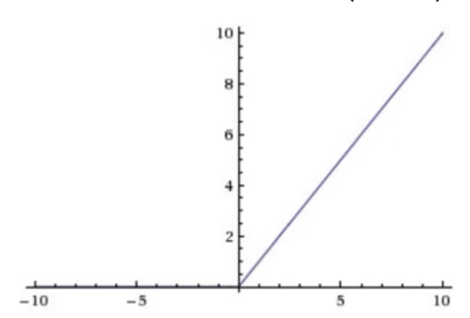
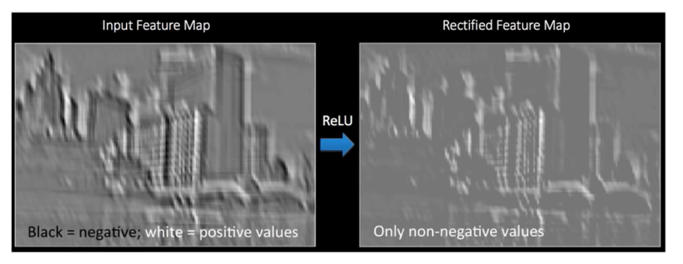
Introducing Non-Linearity
Rectified Linear Unit (ReLU)
Apply after every convolution operation (i.e. after convolutional layers)
ReLU: pixel-by-pixel operation that replaces all negative values by zero. Non-Linear operation
tf.keras.layers.ReLU

Slide 47
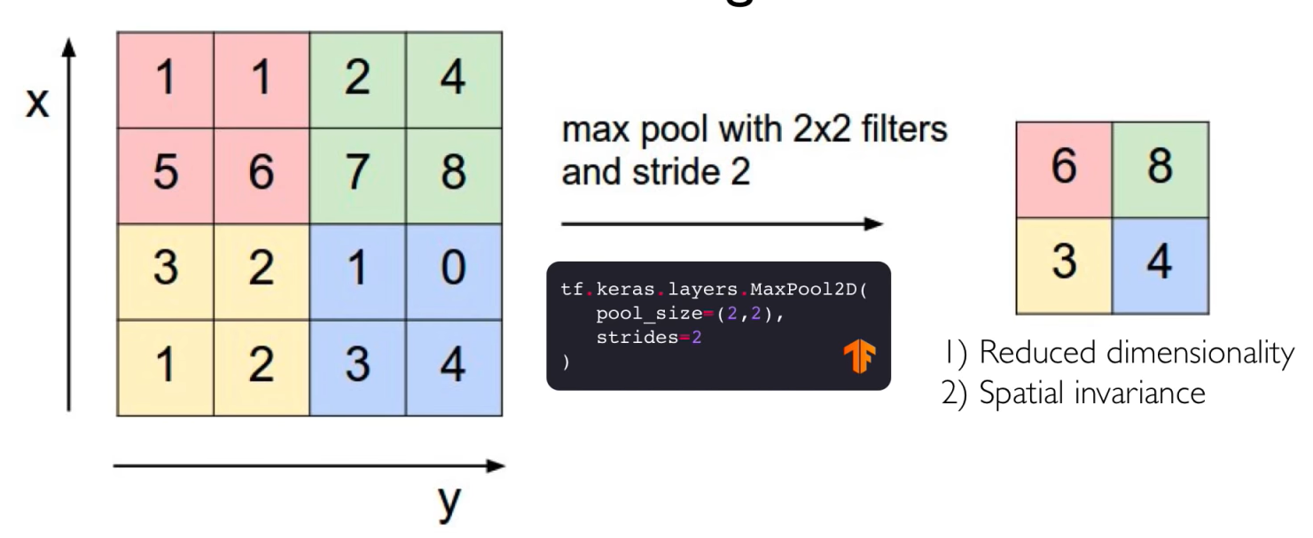

Pooling
Max pool with 2x2 filters and stride 2
Reduced dimensionality
Spatial invariance
How else can we downsample and preserve spatial invariance?

Slide 48
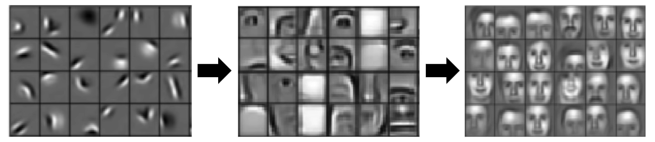
Representation Learning in Deep CNNs
Low level features
Mid level features
High level features
Edges, dark spots
Eyes, ears, nose
Facial structure
Conv Layer 1
Conv Layer 2
Conv Layer 3

Slide 49
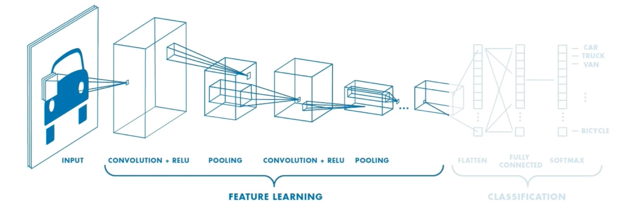
CNNs for Classification: Feature Learning
Learn features in input image through convolution
Introduce non-linearity through activation function (real-world data is non-linear
Reduce dimensionality and preserve spatial invariance with pooling

Slide 50
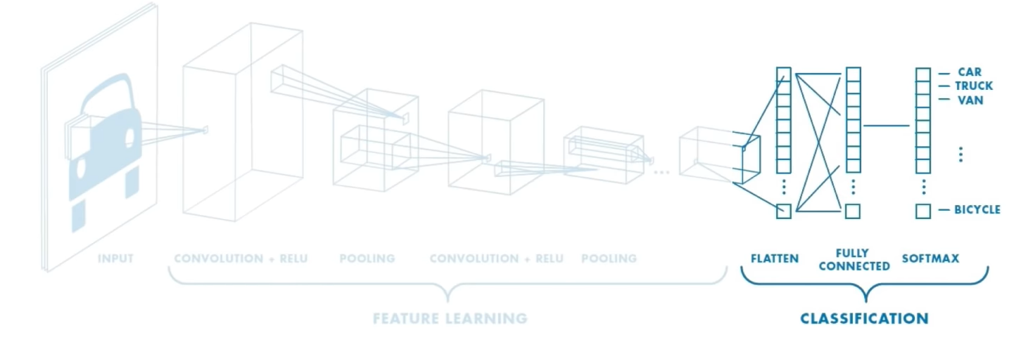
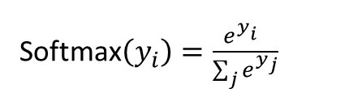
CNNs for Classification: Class Probabilities
CONV and POOL layers output high-level features of input
Fully connected layer uses these features for classifying input image
Express output as probability of image belonging to a particular class
Softmax$\left(y_{i}\right)=\frac{e^{y_{i}^{}}}{\sum_{j}{e^{y_{j}}}}$

Slide 51
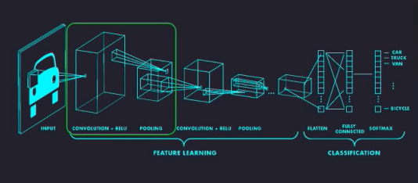
Putting it All Together
import tensorflow as tf
def generate_model():
model = tf.keras.Sequential([
#first convolutional layer
tf.keras.layers.Conv2D(32, filter_size=3, activation=‘relu’),
tf.keras.layers.MaxPool2D(poolsize=2, strides=2),
#second convolutional layer
tf.keras.layers.Conv2D(64, filter_size=3, activation=‘relu’),
tf.keras.layers.MaxPool2D(poolsize=2, strides=2),
#fully connected classifier
tf.keras.layers.flatten(),
tf.keras.layers.Dense(1024, activation=‘relu’),
tf.keras.layers.Flat(10, activation=‘softmax’), #10 outputs
])
return model

Slide 52
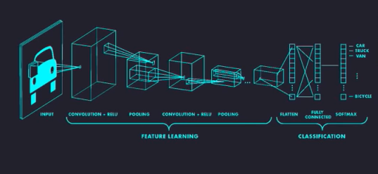
Putting it All Together
import tensorflow as tf
def generate_model():
model = tf.keras.Sequential([
#first convolutional layer
tf.keras.layers.Conv2D(32, filter_size=3, activation=‘relu’),
tf.keras.layers.MaxPool2D(poolsize=2, strides=2),
#second convolutional layer
tf.keras.layers.Conv2D(64, filter_size=3, activation=‘relu’),
tf.keras.layers.MaxPool2D(poolsize=2, strides=2),
#fully connected classifier
tf.keras.layers.flatten(),
tf.keras.layers.Dense(1024, activation=‘relu’),
tf.keras.layers.Flat(10, activation=‘softmax’), #10 outputs
])
return model

Slide 53
Putting it All Together
import tensorflow as tf
def generate_model():
model = tf.keras.Sequential([
#first convolutional layer
tf.keras.layers.Conv2D(32, filter_size=3, activation=‘relu’),
tf.keras.layers.MaxPool2D(poolsize=2, strides=2),
#second convolutional layer
tf.keras.layers.Conv2D(64, filter_size=3, activation=‘relu’),
tf.keras.layers.MaxPool2D(poolsize=2, strides=2),
#fully connected classifier
tf.keras.layers.flatten(),
tf.keras.layers.Dense(1024, activation=‘relu’),
tf.keras.layers.Flat(10, activation=‘softmax’), #10 outputs
])
return model

Slide 54
Putting it All Together
import tensorflow as tf
def generate_model():
model = tf.keras.Sequential([
#first convolutional layer
tf.keras.layers.Conv2D(32, filter_size=3, activation=‘relu’),
tf.keras.layers.MaxPool2D(poolsize=2, strides=2),
#second convolutional layer
tf.keras.layers.Conv2D(64, filter_size=3, activation=‘relu’),
tf.keras.layers.MaxPool2D(poolsize=2, strides=2),
#fully connected classifier
tf.keras.layers.flatten(),
tf.keras.layers.Dense(1024, activation=‘relu’),
tf.keras.layers.Flat(10, activation=‘softmax’), #10 outputs
])
return model

Slide 55
An Architecture for Many Applications

Slide 56
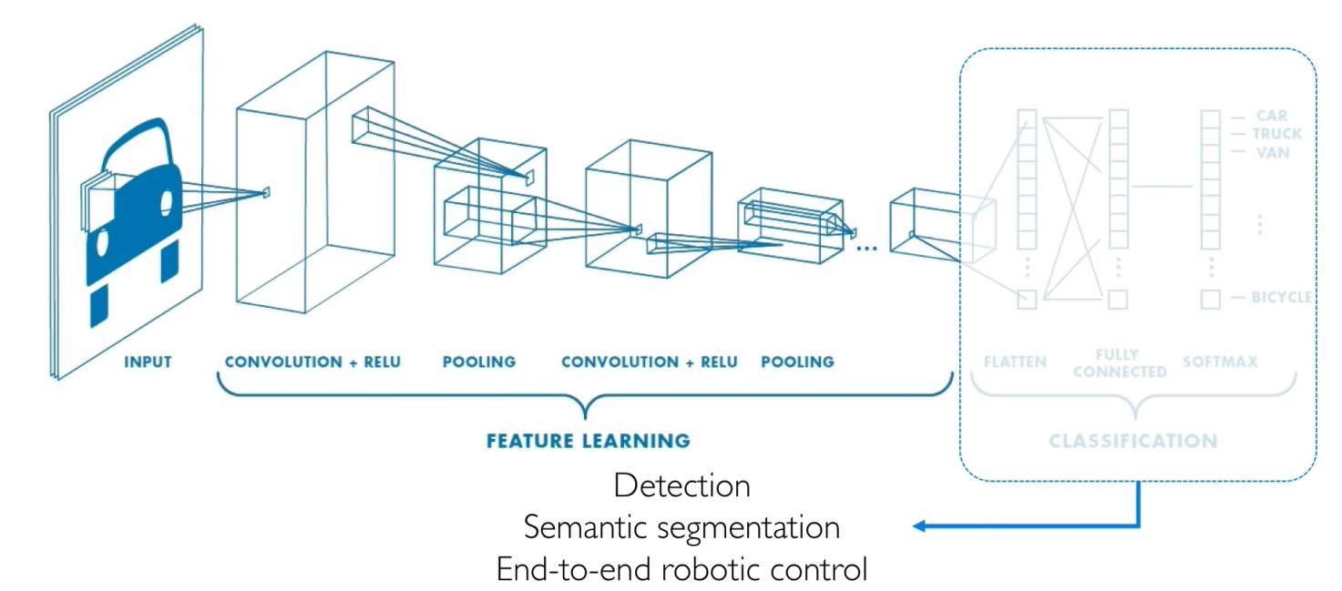
An Architecture for Many Applications
Detection
Semantic segmentation
End-to-end robotic control

Slide 57
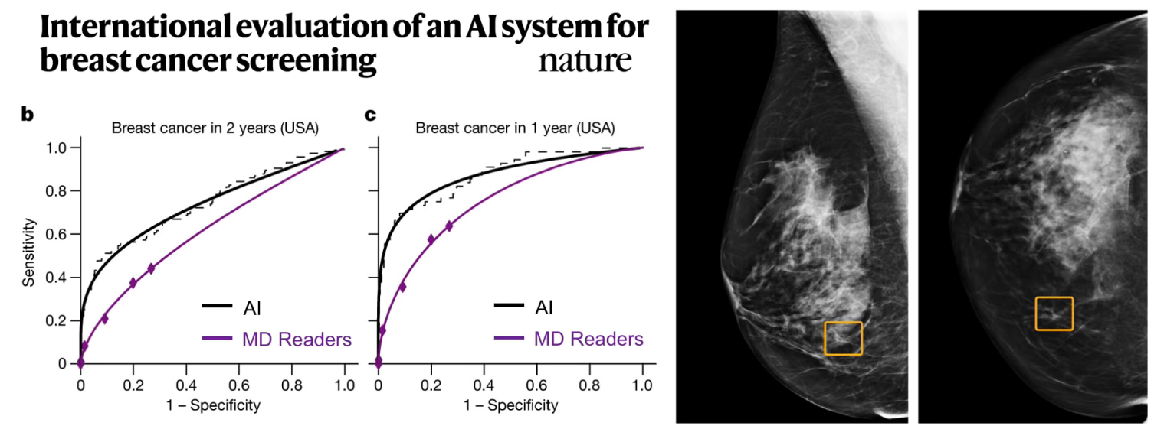
Detection: Breast Cancer Screening
CNN- based system outperformed expert radiologists at detecting breast cancer from mammograms
Breast cancer case missed by radiologist but detected by AI

Slide 58
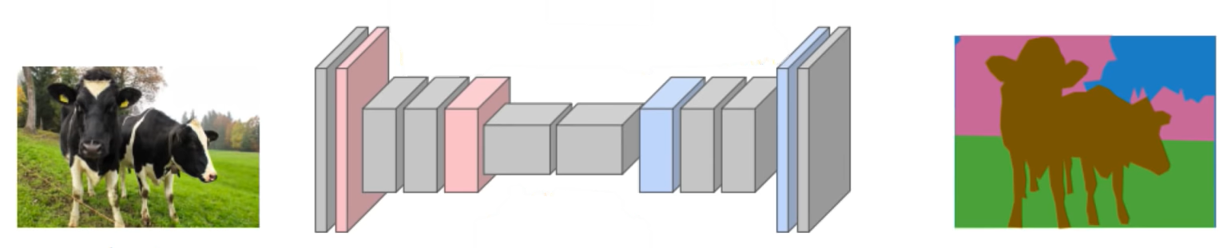
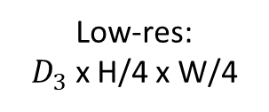
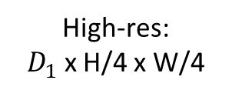



Semantic Segmentation: Fully Convolutional Networks
FCN: Fully Convolutional Network.
Network designed with all convolutional layers with downsampling and upsampling operations
Med-res:
$D_{2}$ x H/4 x W/4
Med-res:
$D_{2}$ x H/4 x W/4
Low-res:
$D_{3}$ x H/4 x W/4
Input:
3x H x W
High-res:
$D_{1}$ x H/4 x W/4
High-res:
$D_{1}$ x H/4 x W/4
Predictions:
H x W
tf.keras.layers.Conv2DTranspose

Slide 59

Semantic Segmentation: Biomedical Image Analysis
Brain Tumors
Dong+ MIUA 2017.
Malaria Infection
Soleimany+ arXiv 2019.

Slide 60

Self-Driving Cars: Navigation from Visual Perception
Possible Control Commands
Raw perception
I
(ex. camera)
Coarse Maps
M
(ex. GPS)

Slide 61

End-to-End Framework for Autonomous Navigation
Entire model is trained end-to-end without any human labelling or annotations
© Alexander Amini and Ava Soleimany MIT 6.S191: Introduction to Deep Learning IntroToDeepLearning.com

Slide 62

End-to-End Framework for Autonomous Navigation
Entire model is trained end-to-end without any human labelling or annotations
© Alexander Amini and Ava Soleimany MIT 6.S191: Introduction to Deep Learning IntroToDeepLearning.com

Slide 63


Slide 64

Deep Learning for Computer Vision: Impact
© Alexander Amini and Ava Soleimany MIT 6.S191: Introduction to Deep Learning IntroToDeepLearning.com

Slide 65


Deep Learning for Computer Vision: Summary
Foundations
CNNs
Applications
Why computer vision?
Representing Images
Convolutions for feature extraction
CNN architecture
Application to classification
ImageNet
Segmentation, image captioning, control
Security, medicine, robotics

